Slide 1
CF PROJECT
WELCOME EVERYONE

Slide 2

Computer Fundamentals
MONTH20XX
Let's Start - - --->

Slide 3
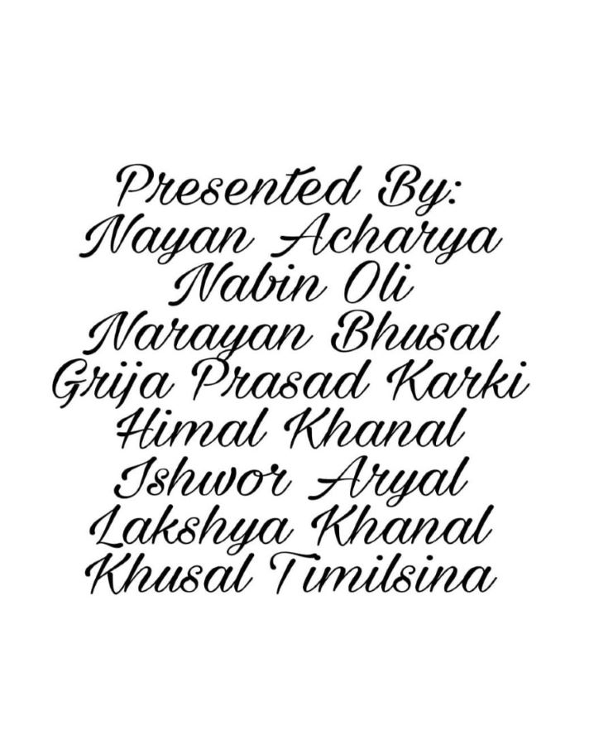

Slide 4
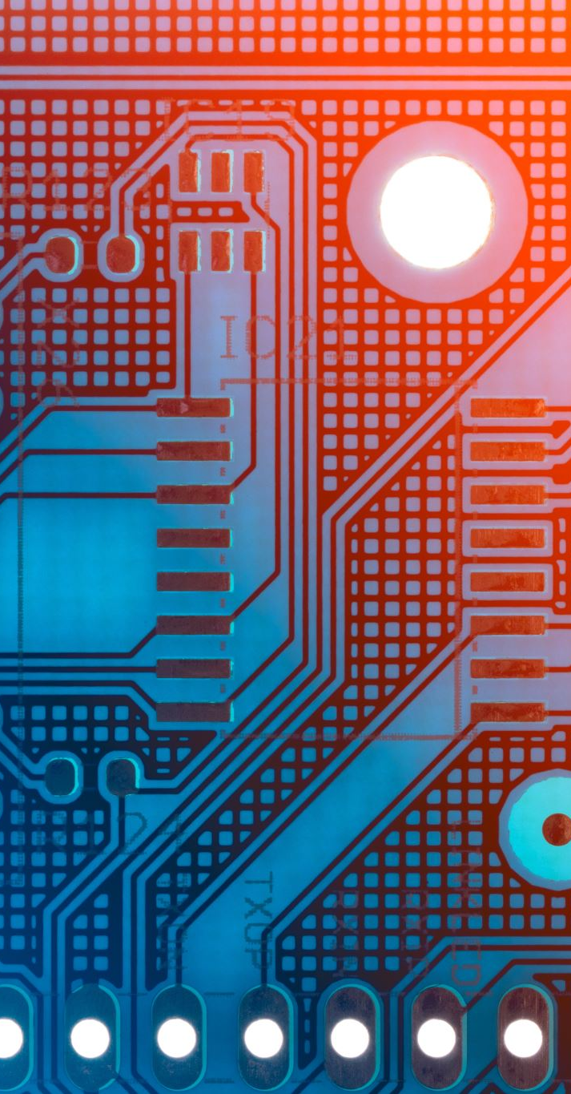
Contents
Unit : 1
Introduction to Computer
Characteristics of computer
Application area of computer
Unit : 2
Input unit
Processing unit

Slide 5
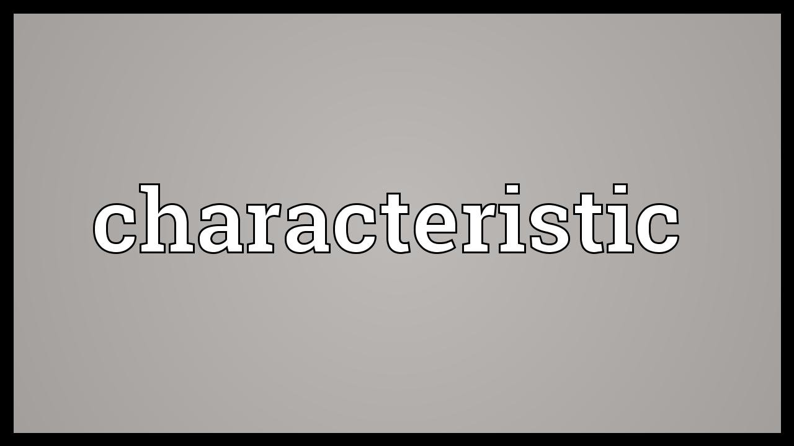
Characteristics of Computer

Slide 6
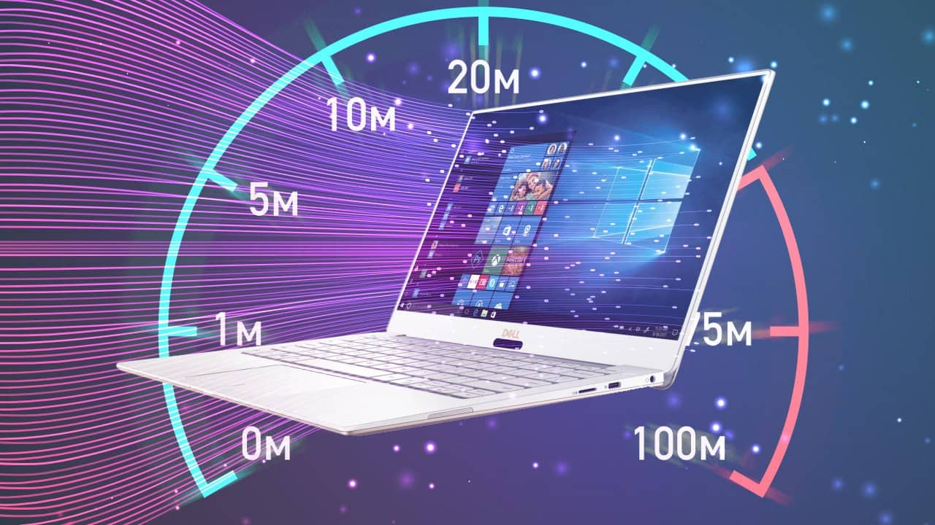
Speed
A computer's processor clock speed determines how quickly the central processing unit (CPU) can retrieve and interpret instructions. This helps your computer complete more tasks by getting them done faster. Clock speeds are measured in gigahertz (GHz), with a higher number equating to higher clock speed.

Slide 7
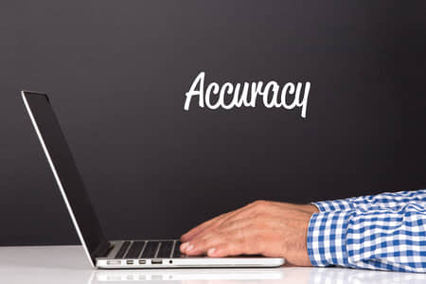
Accuracy
Computer are being able to perform every task with the same accuracy. Computers are always 100% accurate.If the fed the wrong dta obviously it will give the wrong output. This term in computer is called Garbage In Garbage Out(GIGO).

Slide 8
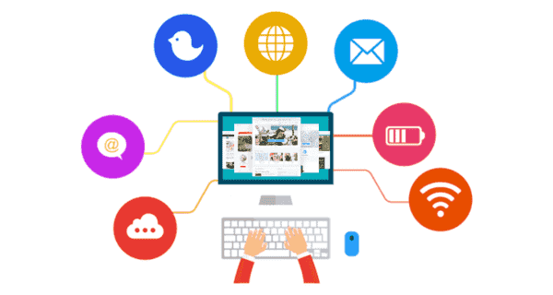
Versatility
Computer is a versatile machine. It caperform a wide range of tasks. it can work from data entry and ticket booking to complex mathematical calculations and continuous actronomical observation.It can be used in different feilds like education, hospital, science, business, etc

Slide 9
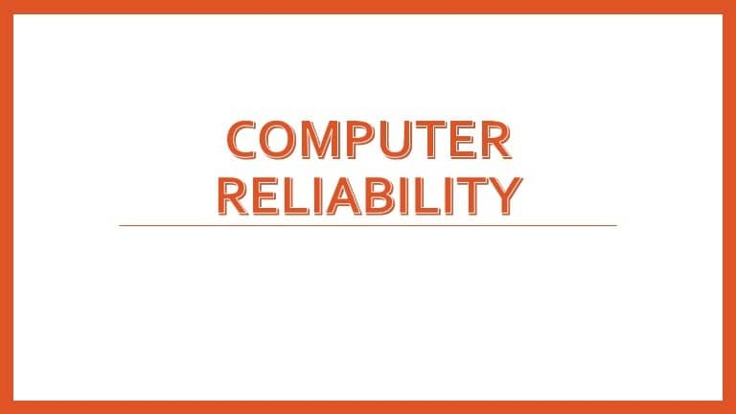
Reliablity
Reliability is how well the computer system performs; they require functions that it has been designed for and do them form without failure. The major reason behind the reliability of computer is that itorks on the instructions given by the user which is already trusted.

Slide 10

Deligence
Computer is free from monotony, tiredness, and lack of concerntration. It is capable of doing the required tasks again and again with the same speed, accuracy and efficiency. It never gats tired, bored or lazy to do any kind of work.

Slide 11
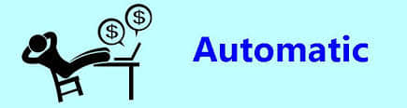
Automatic
Computer can carry out the given job without any human intervation. Once we enter the appropriate data and instructions, a computer can do operationsautomatically. As it is programmed to do so.

Slide 12
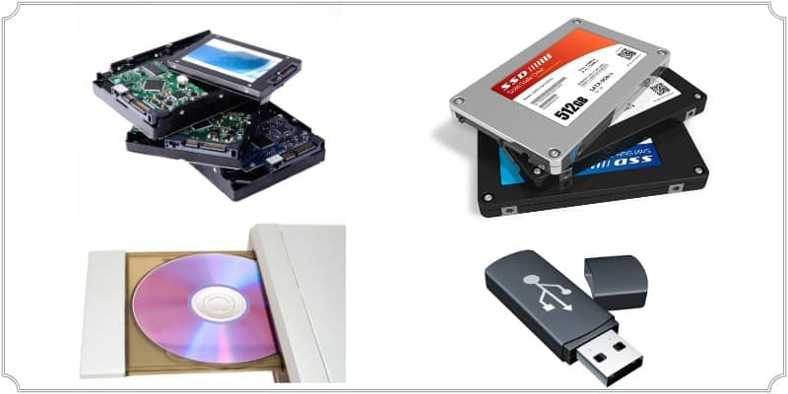
Storage
Computer can store large amount of data and it can recall the rwequired information on demand. Hard Disk Drive(HDD), Solid State Drive*(SSD), Ram, Rom are the example of storage device.

Slide 13
Speed
Storage Measurement Table
o or 1
4 bit
8 bit
1024 byte
1024 kb
1024 mb
1024 gb
1024 tb
1 bit
1 nibble
1 byte
1 kilo byte
1 mega byte
1 giga byte
1 terabyte
1 peta byte

Slide 14
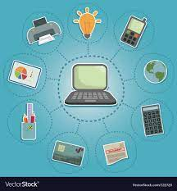
Application Area of computer

Slide 15

Education
Computers can be used for online education & research. With the help of the internet, students can find useful information about their projects, assignments and also can take useful help from other researchers as they store & organize their research materials in computers.

Slide 16
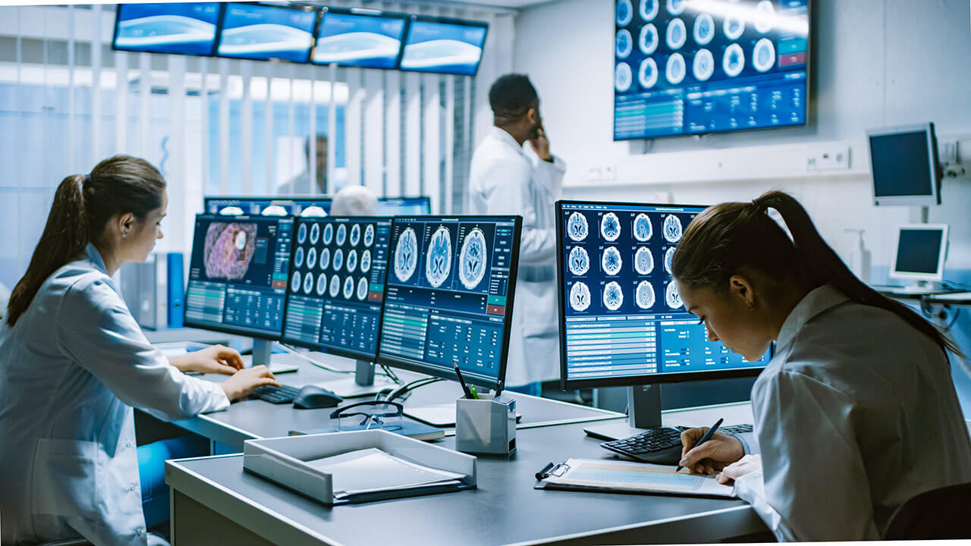
HOSPITAL
Major uses of computers in hospital include hospital information system, data analysis in medicine, medical imaging laboratory computing, computer assisted medical decision making, care of critically ill patients, computer assisted therapy and so on.

Slide 17
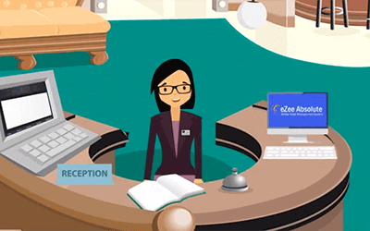
HOTEL
The most apparent manifestation of technology in the hotel industry is hotel bookings. The internet also obviously makes accessing information easy, and transparent. Data such as check-in and checkout times, rates, facilities on offer, and other key details allow guests to make informed decisions.

Slide 18
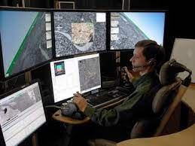
MILITARY
Computer technology is helping create new advantages for infantry and armor. Things like guided munition systems, rocket and explosive defense systems for tanks or APCs, advanced biosensors for soldiers, 3D printable weaponry, and other noticeable trends in soldier tech.

Slide 19

E-COMMERCE
Ecommerce, also known as electronic commerce or internet commerce, refers to the buying and selling of goods or services using the internet, and the transfer of money and data to execute these transactions. Ecommerce is often used to refer to the sale of physical products online, but it can also describe any kind of commercial transaction that is facilitated through the internet.

Slide 20

CLASSIFICATION OF COMPUTER
ON THE BASIS OF PURPOSE

Slide 21
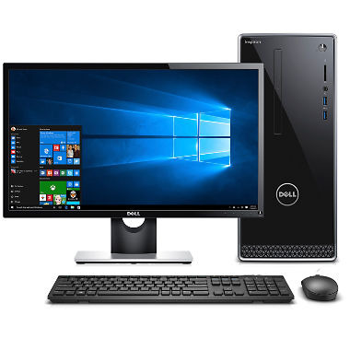
GENERAL PURPOSE COMPUTER
It is the commonly used computer which are designed to perform more than one task. These type of computer are mainly used in homes and offices, etc. for data processing, communications, graphics, designing etc. The microcomputer such as laptops, PC, Notebooks etc are general purpose computer

Slide 22
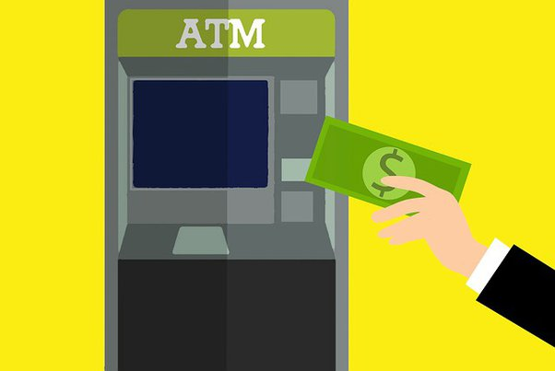
Special purpose computer
It is designed to perform single specific tasks and have limited area of applications. The programs on these computer are loaded at the time of manufacturing which cannot be changed. The modern washing machines, self driven cars, atm, etc are the examples of special purpose computer.

Slide 23
General Purpose Computer
Special Purpose Computer
It can perform more than one task.
Re-programming is possible.
It is comparatively slower than special purpose computer.
It has wide range of applications.
Examples: Laptop, Notebooks, Desktop etc.
It can perform only a single specific task.
Re-programming is not possible.
It is comparatively faster than general purpose computer.
It has less area of applications.
Example: Washing machines, Self driven cars, etc.

Slide 24
Classification of compter
On the basis of Data Type

Slide 25
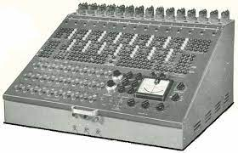
Analog Computer
Analog computers are used to process analog data. Analog data is of continuous nature and which is not discrete or separate. Such type of data includes temperature, pressure, speed weight, voltage, depth etc. These quantities are continuous and having an infinite variety of values.

Slide 26
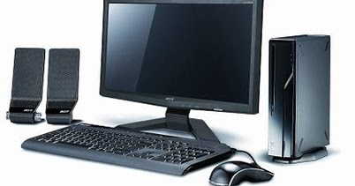
Digital computer
A computer that works with digital value 0 and 1,where 0 is off and 1 is on .It works with discrete data. Most of the electronic system is based on the digital system . Digital computers are very popular for actual computer works like preparation of the report , documentation , billing and graphical work etc . The entire PC used today on different fields are digital computers.

Slide 27
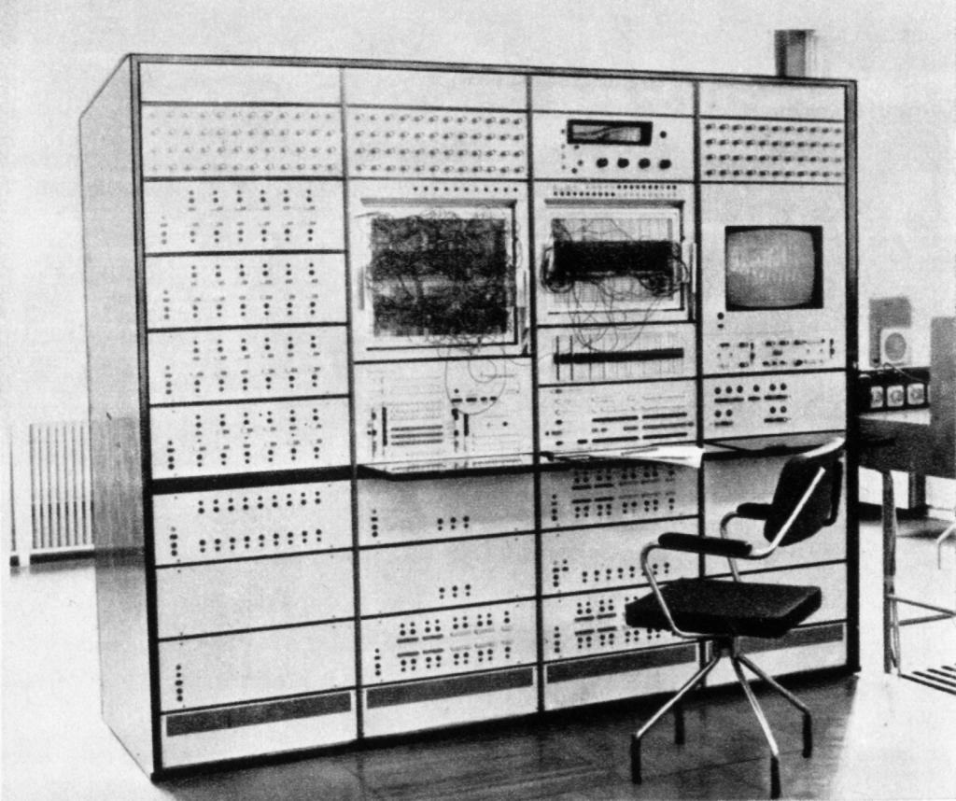
Hybrid Computer
Hybrid computer is the combination of analog and digital computer. It works with continuous and discrete value . These are used in ICU of the hospital, jet planes and other data analysis terminals . Hybrid computer transfers the data from analog to digital and digital to analog and vice versa.

Slide 28
Classification of compter
On the basis of Model

Slide 29
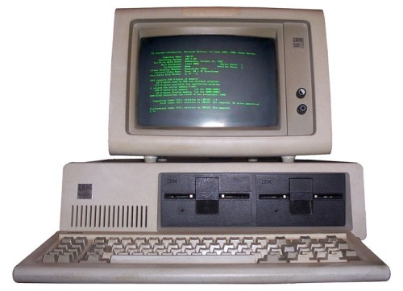
XT Computer
XT stand for Extended Technology .It does not support GUI(Graphical User Interface).Its processing speed is 4.77MHz and Intel 8080, 8086, 8088,etc are the series of microprocessor which are used.

Slide 30
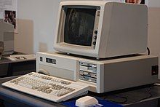
AT Computer
AT computer stands for Advance Technology . It supports GUT(Graphical User Interface).Its speed is 2GHz and word length 64 bits . Its processors are Intel series of 80286,80386,ptium,etc.

Slide 31
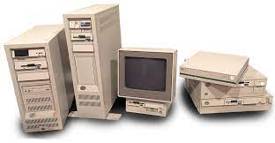
PS/2 Computer
It is a laptop computer which is rechargeable and based system. It is operated with OS/2 operating system.

Slide 32
Computer Classification on the basis of brand
IBM PC
Apple/Macintosh Computer
IBM Compatible

Slide 33
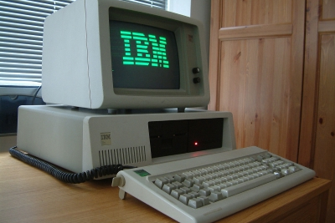
IBM PC
The IBM Personal Computer (model 5150, commonly known as the IBM PC) is the first microcomputer released in the IBM PC model. It was released on August 12, 1981, it was created by a team of engineers and designers. It uses MS-DOS (operating system that uses command for input and output).

Slide 34
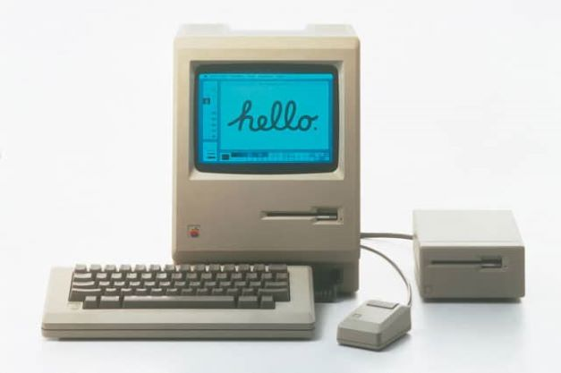
Apple/Macintosh Computer
The Macintosh (mainly Mac since 1998)[1] is a family of personal computers designed and manufactured by Apple Inc. The Macintosh is the first successful mass-market all-in-one desktop personal computer to have featured a graphical user interface, built-in screen, and mouse.

Slide 35
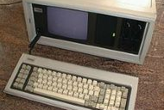
IBM Compatible
The term 'compatible' means able to exist together and successfully. IBM computers can be assembled by using different components of different companies. IBM PC compatible computers are similar to the original IBM PC. Some of the examples of IBM compatible are:

Slide 36
Computers On The Basis Of Size
There are four types in the classifications of the computer by size: Supercomputer, Mainframe computer, Minicomputer, and Micro Computer.

Slide 37
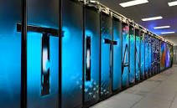
Super Computer
Super computer: A supercomputer is a computer that performs at or near the highest operational rate for computers. Supercomputers have been used for scientific and engineering applications that must handle massive databases.

Slide 38
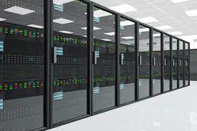
Mainframe Computer
Mainframe Computer:A mainframe computer is a large computer, often used by large businesses, in government offices, or by universities. Mainframe computers are typically: Powerful - they can process vast amounts of data, very quickly. Large - they are often kept in special, air-conditioned rooms.

Slide 39
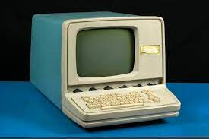
Mini Computer
Mini Computer:A minicomputer, or colloquially mini, is a class of smaller computers that was developed in the mid-1960s and sold for much less than mainframe and mid-size computers from IBM and its direct competitors. hope it helps!! mitgliedd1 and 17 more users found this answer helpful. heart outlined.

Slide 40
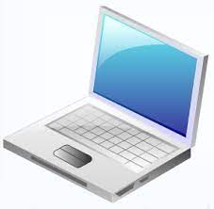
Micro Computer
Micro Computer:An electronic device with a microprocessor as its central processing unit (CPU). Microcomputer was formerly a commonly used term for personal computers, particularly any of a class of small digital computers whose CPU is contained on a single integrated semiconductor chip.

Slide 41
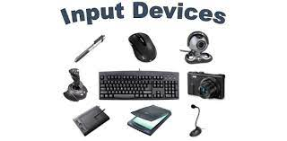
INPUT UNIT

Slide 42
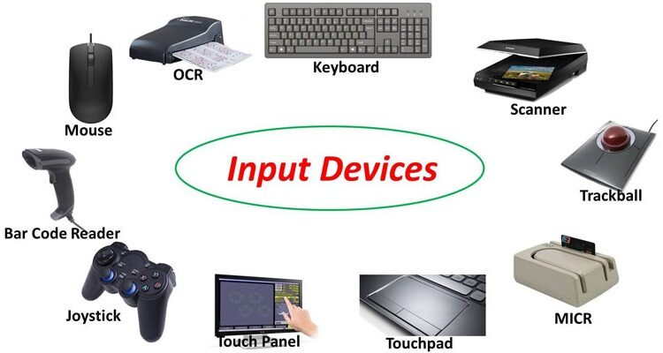
INPUT DEVICE
An input device is any hardware device that sends data to a computer, allowing you to interact with and control it. The input devices perform the following tasks :
Accept the data and instruction from a used other device .
Cover them into computer understand language i.e. machine language .
Supply the converted data to the computer system .
Some of input device are given below:

Slide 43
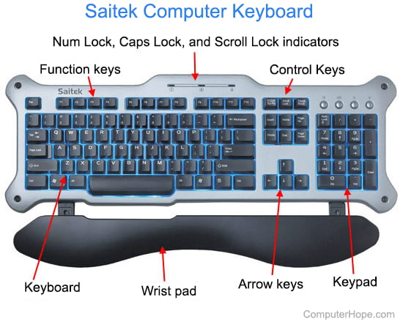
Keyboard
A keyboard is for putting information including letters, words and numbers into your computer. You press the individual buttons on the keyboard when you type. The number keys across the top of the keyboard are also found on the right of the keyboard. The letter keys are in the centre of the keyboard

Slide 44
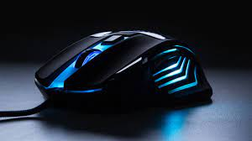
Mouse
The mouse is a small, movable device that lets you control a range of things on a computer. Most types of mouse have two buttons, and some will have a wheel in between the buttons. Most types of mouse connect to the computer with a cable, and use the computer's power to work. Some types of mouse are wireless.

Slide 45
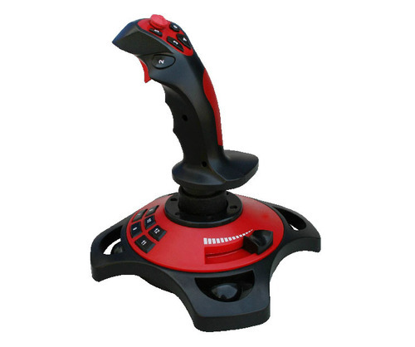
Joystick
In computers, a joystick is a cursor control device used in computer games and assistive technology . The joystick, which got its name from the control stick used by a pilot to control the ailerons and elevators of an airplane, is a hand-held lever that pivots on one end and transmits its coordinates to a computer.

Slide 46
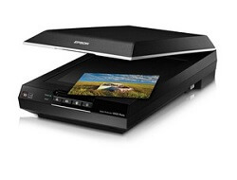
Scanner
A scanner is a input device that captures images from photographic prints, posters, magazine pages and similar sources for computer editing and display. Scanners work by converting the image on the document into digital information that can be stored on a computer through optical character recognition (OCR).

Slide 47
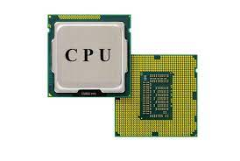
Central PROCESSING UNIT

Slide 48
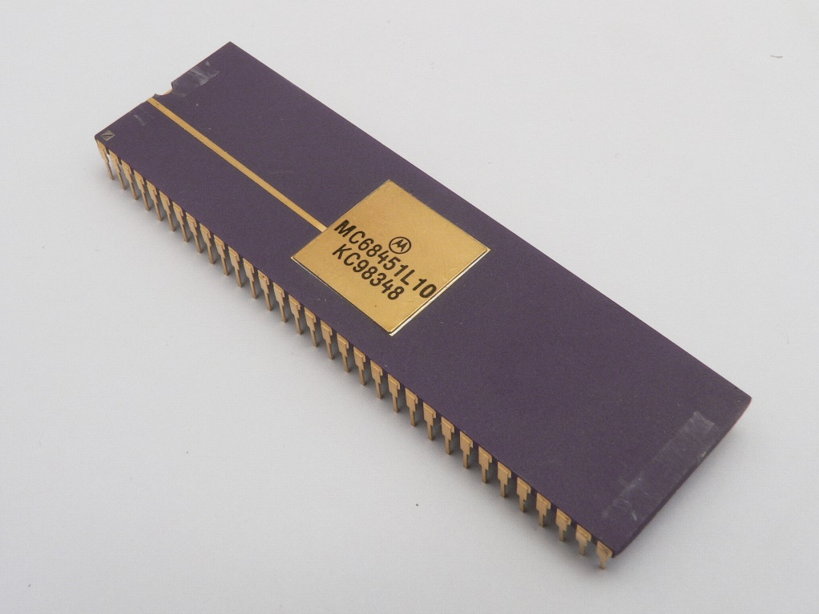
Memory unit
MU
Memory unit
Holds all of the necessary data and instructions for processing. It keeps track of the processing's interim results. Before the final results of processing are sent to an output device, it saves them. The main memory receives and transmits all inputs and outputs.

Slide 49
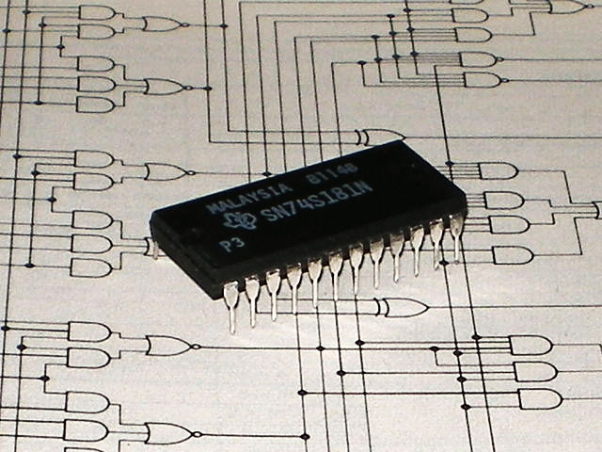
Arithmetic and logic unit
ALU
Arithmetic and logic unit
An arithmetic-logic unit is the part of a central processing unit that carries out arithmetic and logic operations on the operands in computer instruction words. In some processors, the ALU is divided into two units: an arithmetic unit (AU) and a logic unit (LU).

Slide 50
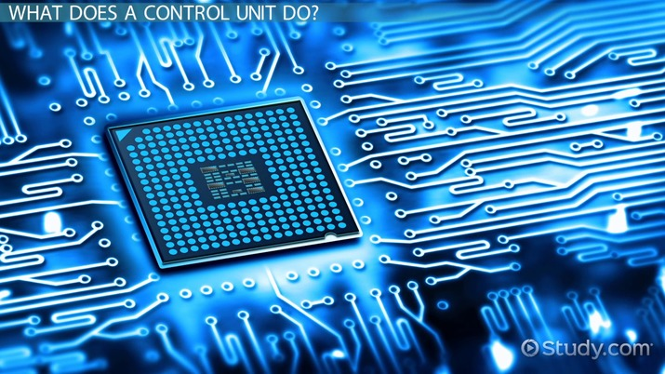
Control unit
CU
The control unit of the central processing unit regulates and integrates the operations of the computer. It selects and retrieves instructions from the main memory in proper sequence and interprets them so as to activate the other functional elements of the system at the appropriate moment .

Slide 51
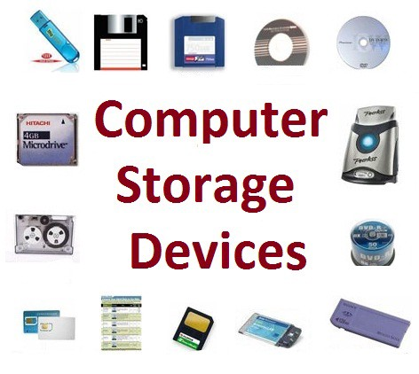
Storage unit
Storage unit
A storage device is any type of computing hardware that is used for storing, porting or extracting data files and objects. Storage devices can hold and store information both temporarily and permanently. They may be internal or external to a computer, server or computing device.

Slide 52
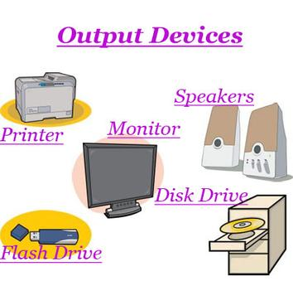
OUTPUT UNIT

Slide 53
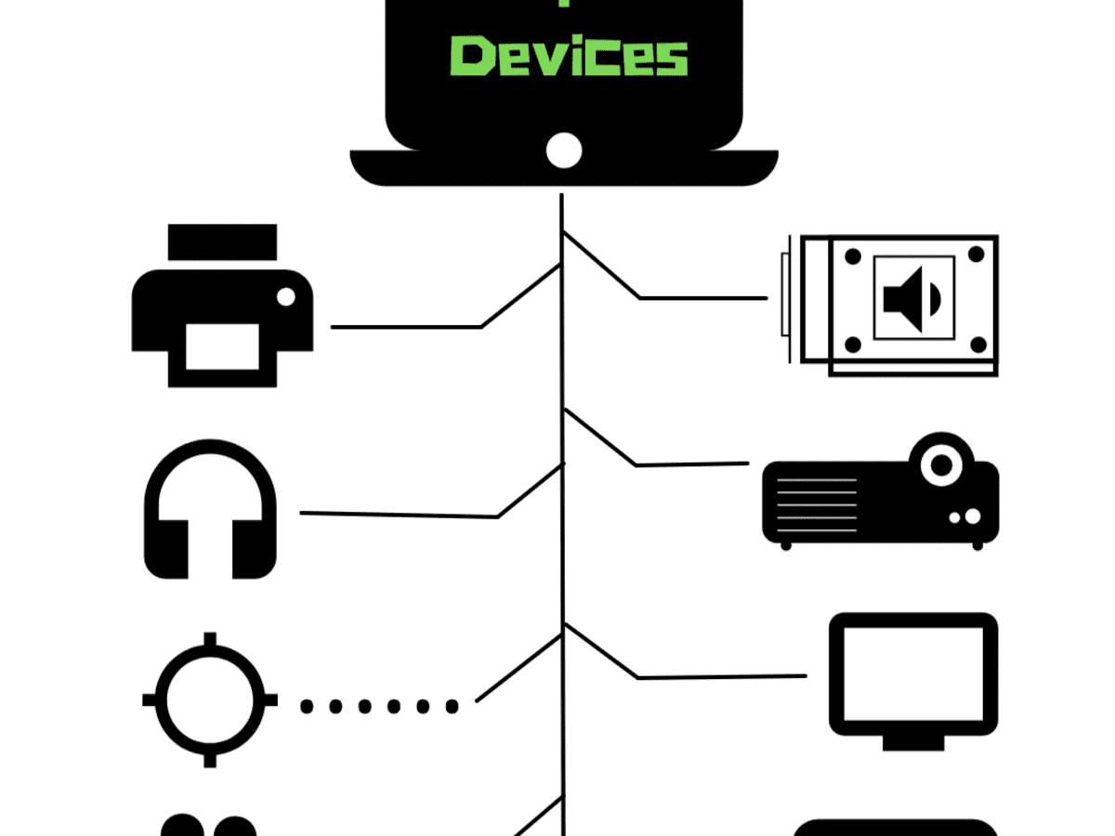
OUTPUT UNIT
A piece of equipment/hardware which gives out the result of the entered input, once it is processed (i.e. converts data from machine language to a human-understandable language), is called an output device. For example printer, monitor, etc. Some of the output devies are exaplaind by me in the next slide.

Slide 54
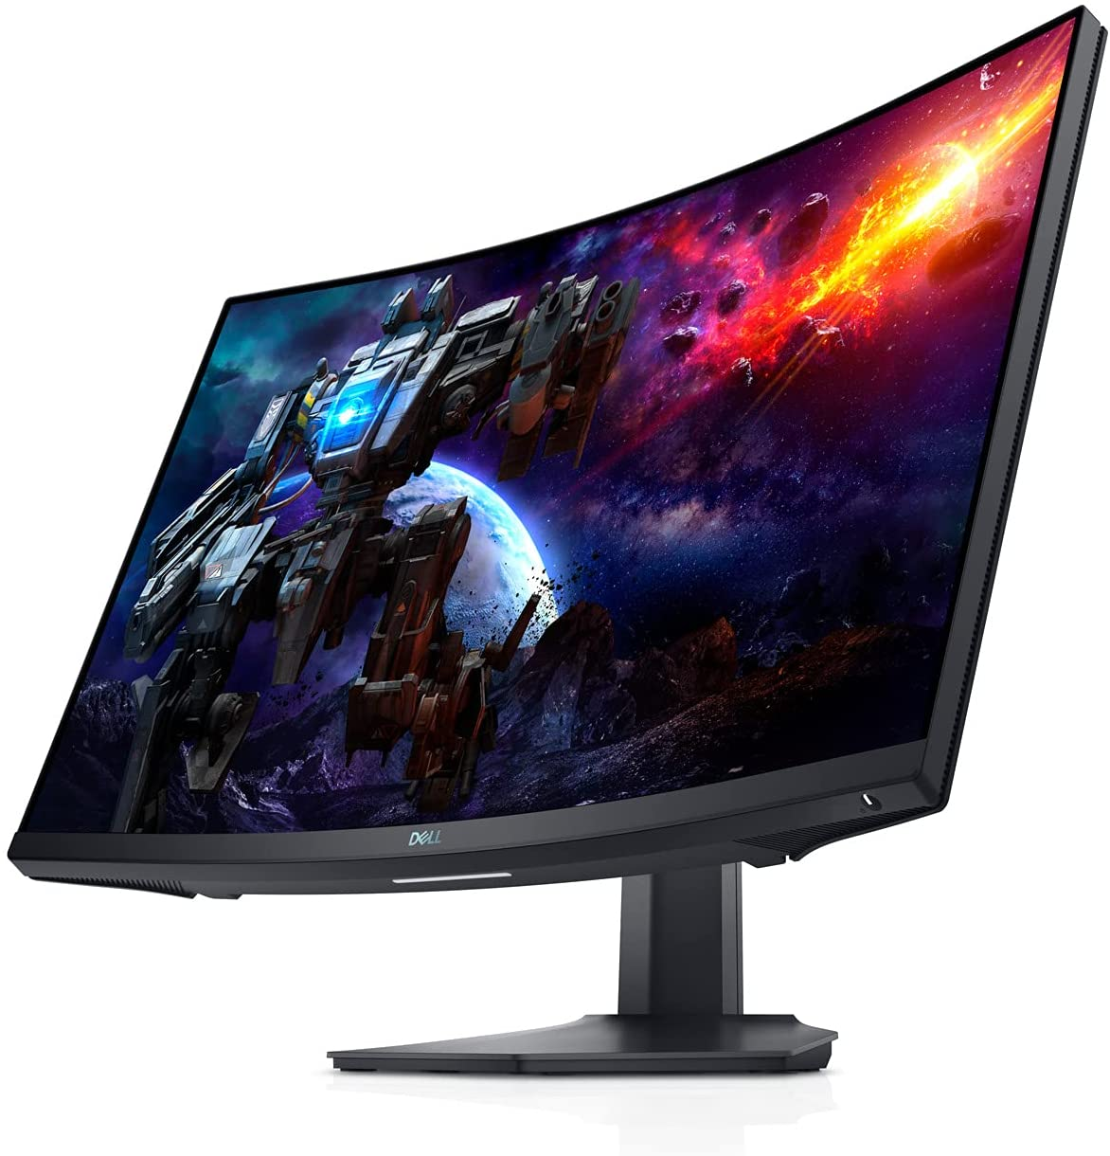
MONITOR
A computer monitor is an output device that displays information in pictorial or text form. A monitor usually comprises a visual display, some circuitry, a casing, and a power supply.Monitor are futher classified into differnet types:
CRT monitors
LCD monitors
LED monitors

Slide 55
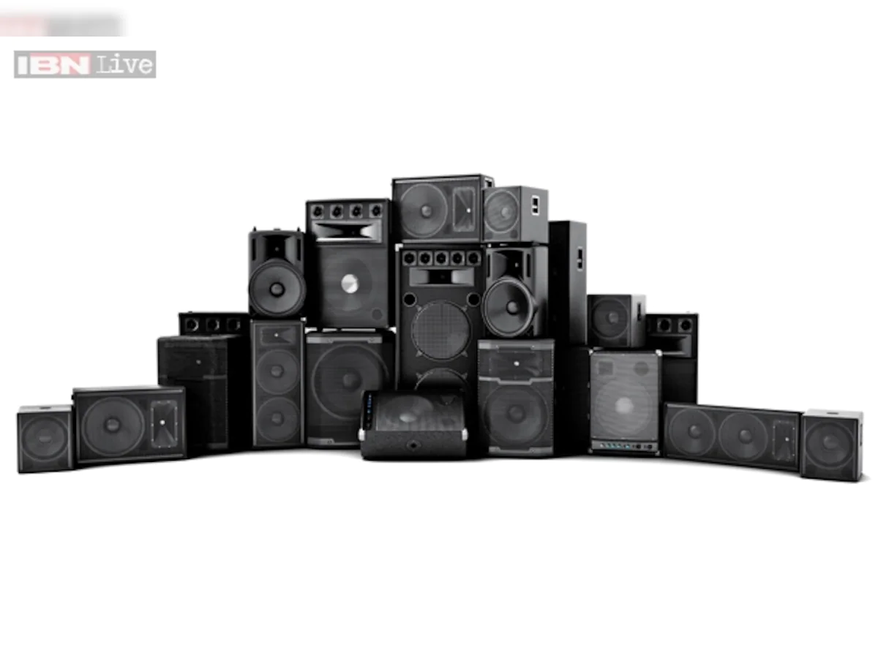
SPEAKERS
A speaker (commonly referred to as a loudspeaker or speaker driver) is an electroacoustic transducer, that is, a device that converts an electrical audio signal into a corresponding sound. A speaker system, also often simply referred to as a "speaker" or "loudspeaker", comprises one or more such speaker drivers, an enclosure, and electrical connections possibly including a crossover network.

Slide 56
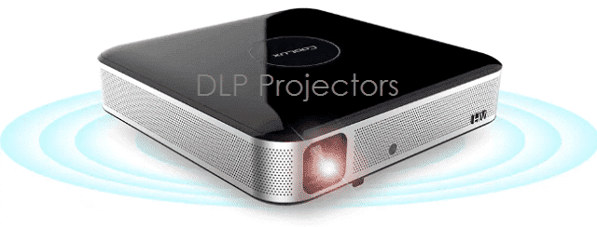
PROJECTOR
A projector or image projector is an optical device that projects an image (or moving images) onto a surface, commonly a projection screen. Most projectors create an image by shining a light through a small transparent lens, but some newer types of projectors can project the image directly, by using lasers.

Slide 57
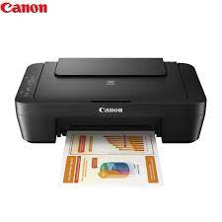
PRINTER
Printer is a hard copy output device.A printer is a device that accepts text and graphic output from a computer and transfers the information to paper. Printer are mainly classified into two types:
Impact Printer
Non-Impact Printer

Slide 58
IMPACT Printer
Non-Impact Printer
It is a type of printer that works by direct contact of an ink ribbon with paper.
These printers are typically loud but remain in use today because of their unique ability to function with multipart forms.
An impact printer has mechanisms resembling those of a typewriter.
Example of Impact Printers are: Dot-matrix printers, Daisy-wheel printers, and line printers.
It is a type of printer that does not hit or impact a ribbon to print.
They used laser, xerographic, electrostatic, chemical and inkjet technologies. Non-impact printers are generally much quieter.
They are less likely to need maintenance or repairs than earlier impact printers.
Example of Non-Impact Printers is Inkjet printers and Laser printers.

Slide 59
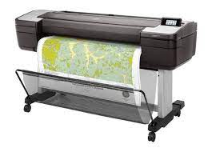
Plotter
A plotter is a machine that produces vector graphics drawings. Plotters draw lines on paper using a pen, or in some applications, use a knife to cut a material like vinyl or leather. In the latter case, they are sometimes known as a cutting plotter.

Slide 60

Thank You Everyone

